Slide 1

RF Microelectronics
Gilbert Cell Mixer
University of Pavia
http://www.unipv.it/aic/
Notes:
La tecnologia CMOS ha storicamente dimostrato di essere economicamente vincente tutte le volte che è in grado di soddisfare le specifiche per una particolare applicazione. La fiducia che questo sarà valido anche nel potenzialmente enorme mercato dei telefoni cellulari di prossima generazione ha motivato il presente lavoro. Questo lavoro è quindi focalizzato sul progetto di un ricevitore interamente integrato per lo standard Europeo dei telefoni cellulari di terza generazione, l’UMTS. Per ottenere questo risultato è stata seguita una metodologia di progetto integrata, si è partiti quindi dalle specifiche di ricezione e trasmissione per il terminale mobile previste dallo standard, sono state comparate diverse architetture di ricezione alternative e si è concluso con il progetto circuitale. Questa metodologia ha permesso la massima efficienza e flessibilità durante l’intero progetto del ricevitore.

Slide 2
Gilbert Cell Active Mixer
“single - balanced” version
Drain current of M1
Transconductance gain
Voltage Gain

Slide 3
Gilbert Cell Active Mixer
“double - balanced” version
Drain Current of M1
Drain Current of M2
Voltage Gain

Slide 4
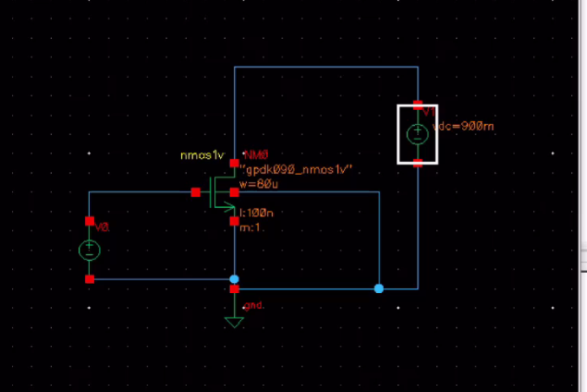
Transconductor Bias
DC Sweep
W=80um L=0.1um 1.5mA

Slide 5
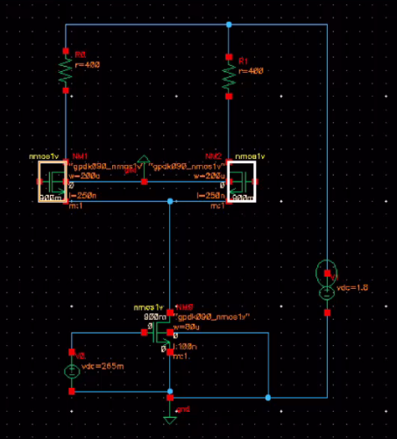
Switching pair and load
1.8V
400Ω
W=200um L=0.25um

Slide 6
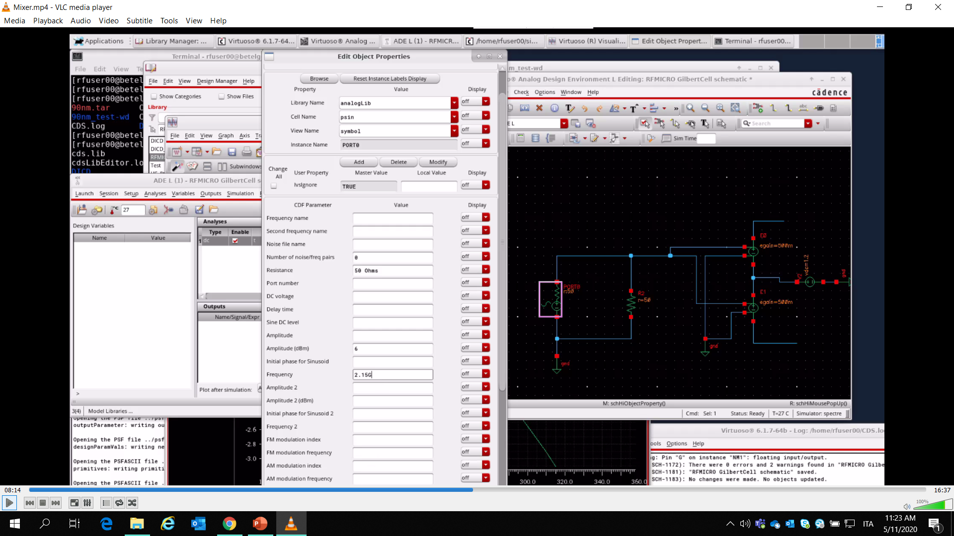
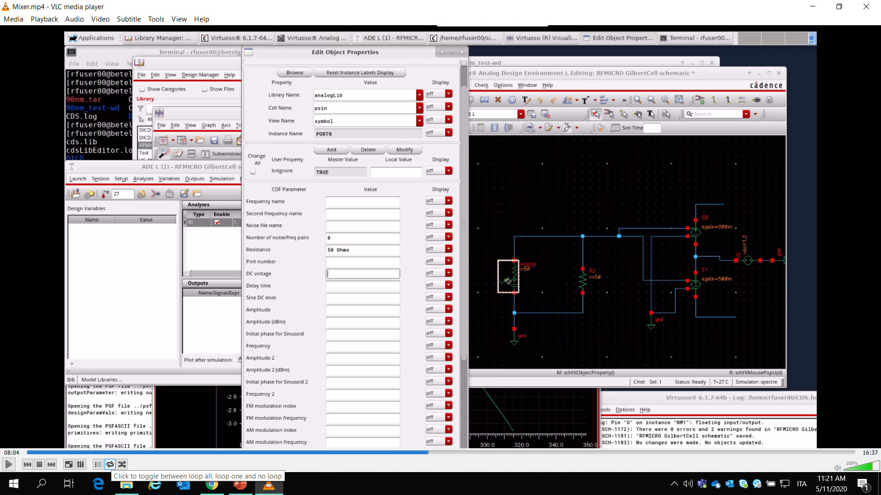
LO port
Gain=0.5
50Ω only for matching
1.2V Bias

Slide 7
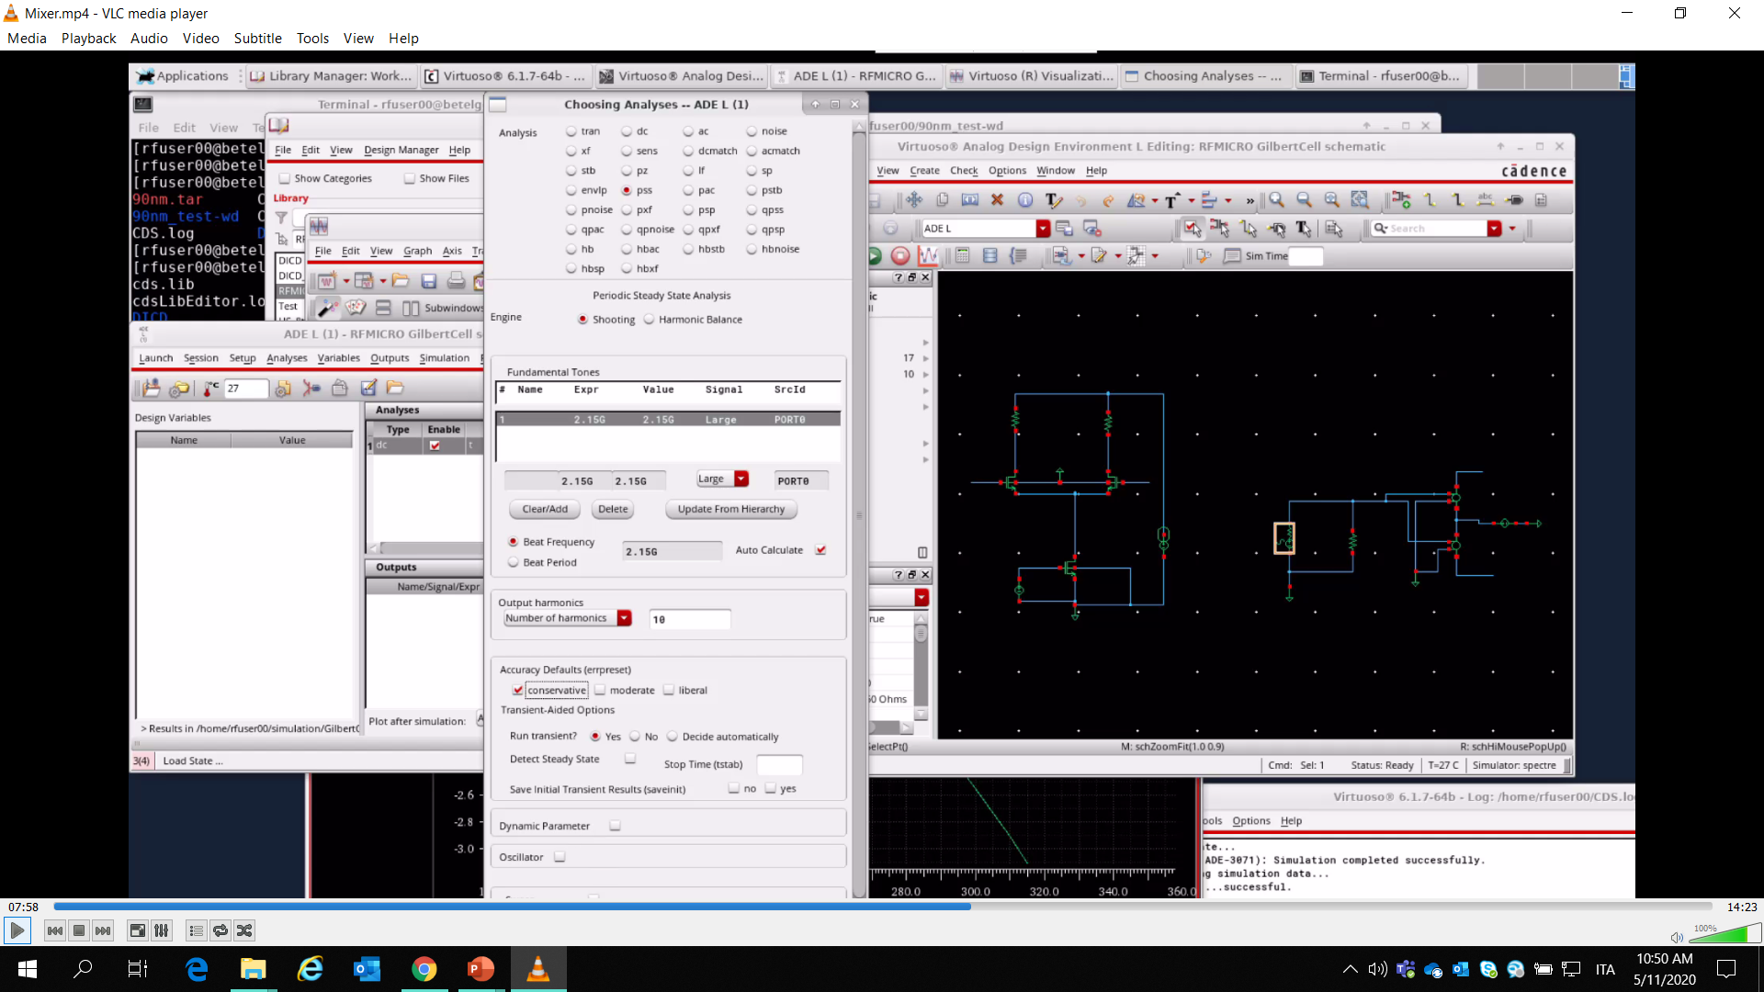
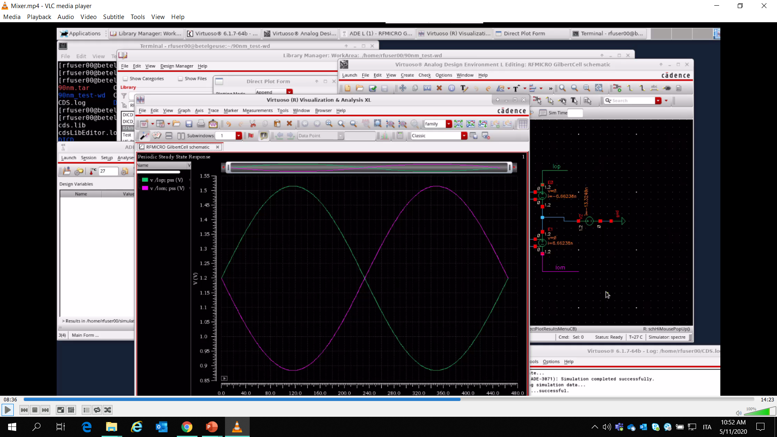
PSS simulation (periodic steady-state)

Slide 8
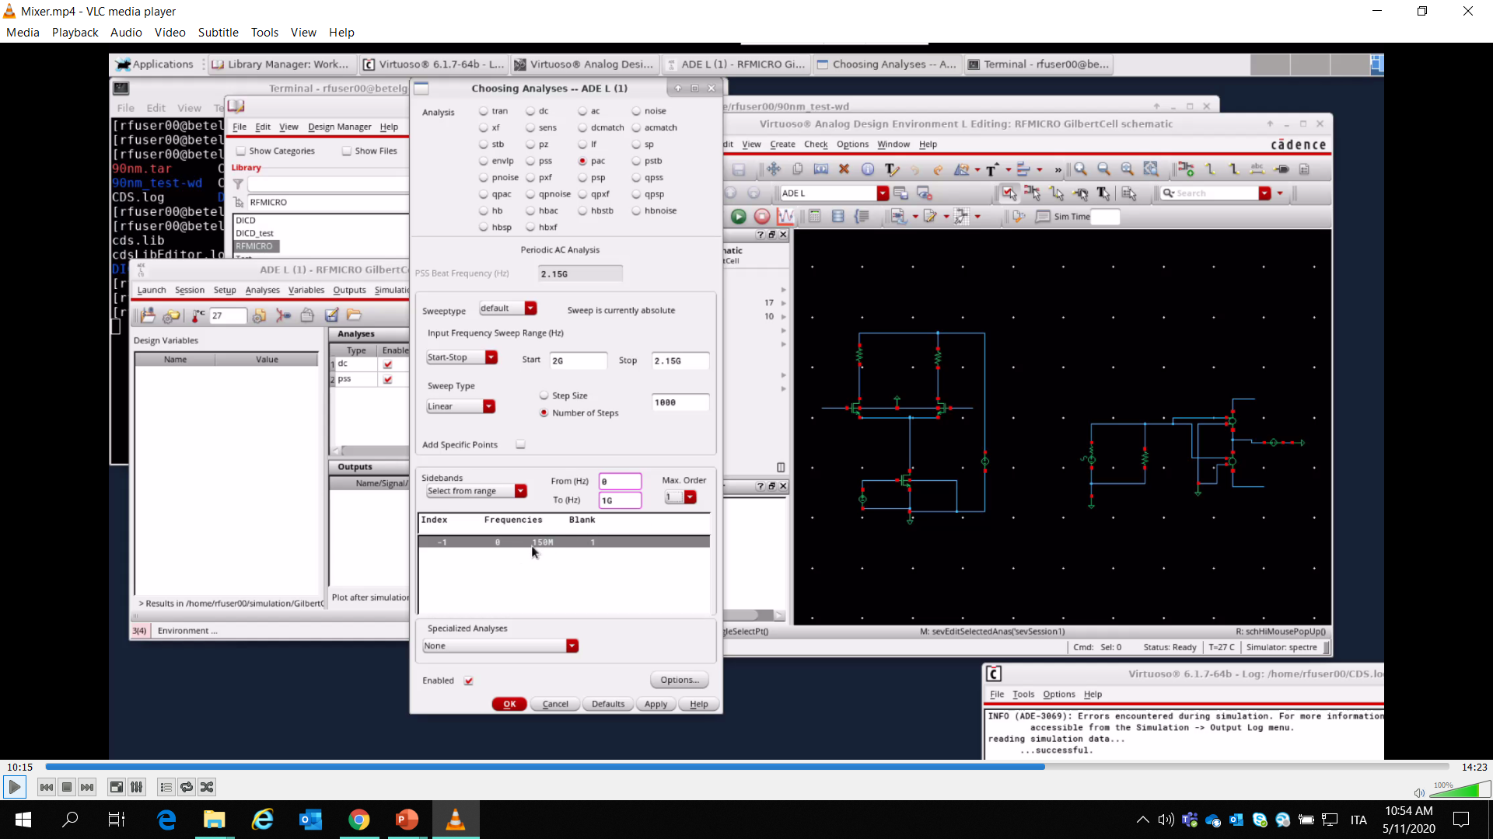
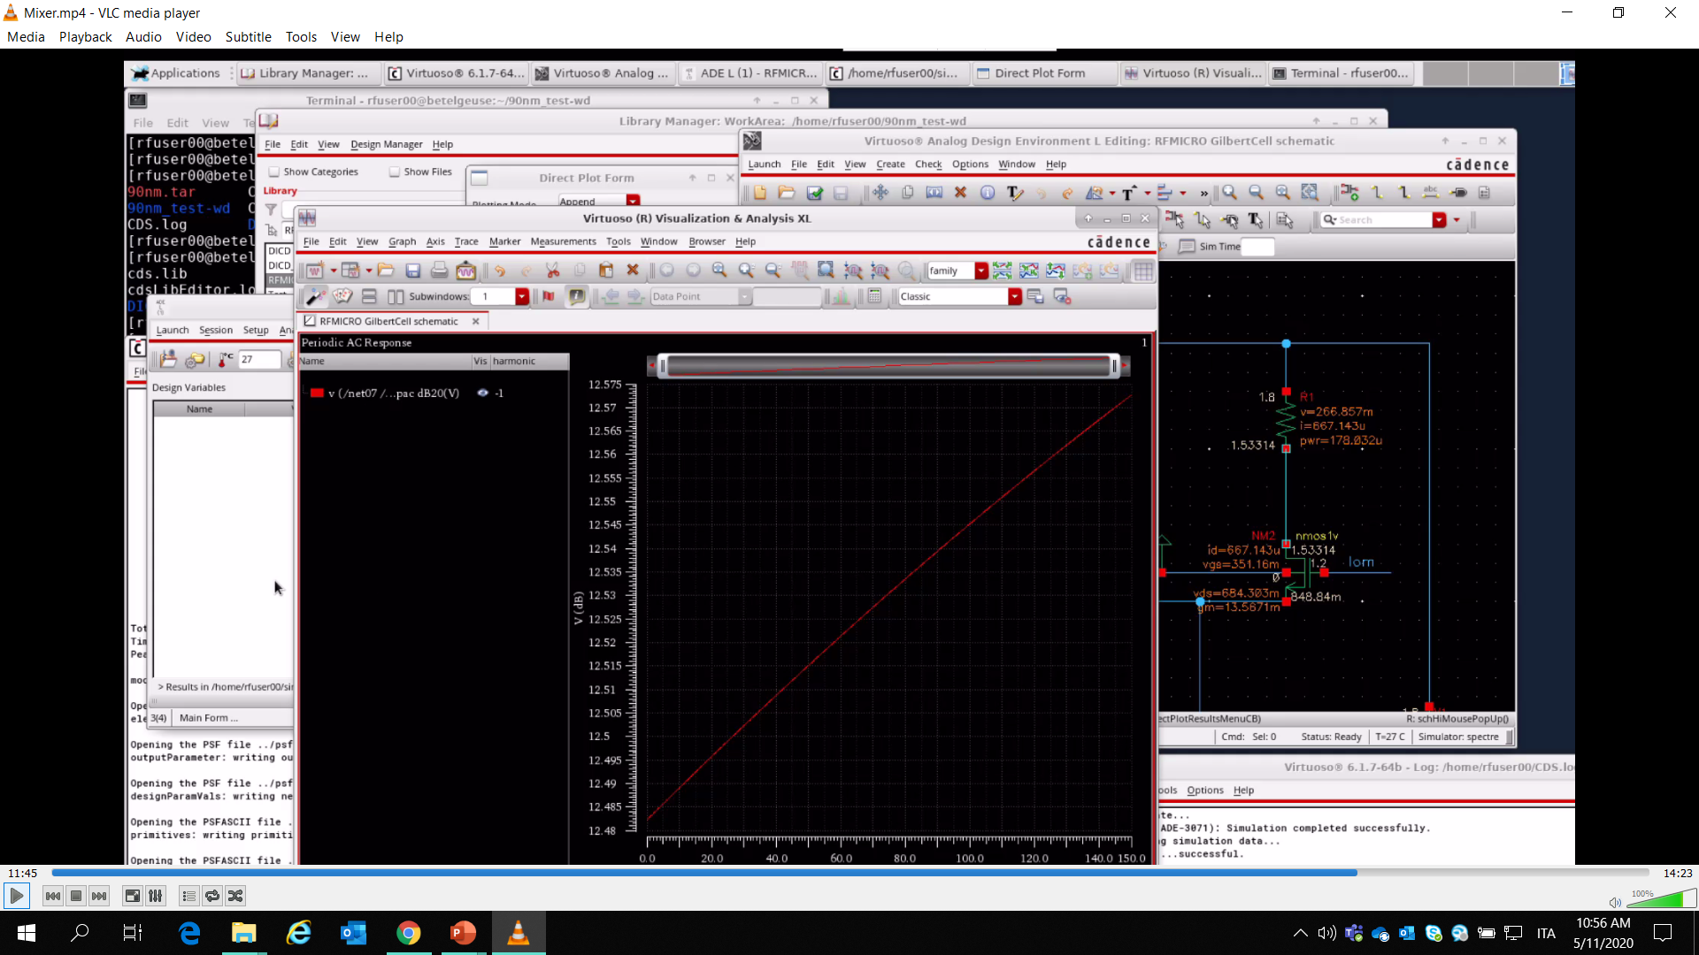
PAC simulation(periodic ac)

Slide 9
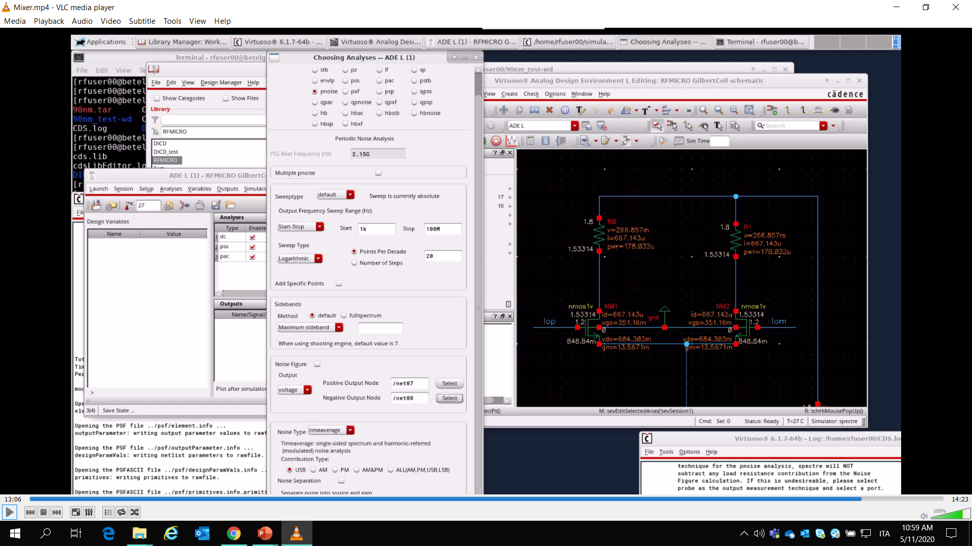

Pnoise Simulation

Slide 10

Question #1
Università degli
Studi di Pavia
What are the key aspects to keep in mind when sizing switching pairs?
1. CMOS fabrication processes with channel lengths (minimum channel ) in the nanoscale range are plagued by several second-order undesired effects, that alter the device’s behavior and strongly limits the accuracy and effectiveness of the square-law equations traditionally used to determine the MOSFET operating point.
2.systematic approach for calculating the W/L transistor’s ratios required for achieving the design specifications. The systematic approach exploits the gm/ID methodology and it is based on a unified treatment of all the regions of operation of the MOS transistor.
3. the framework extracts the transit frequency (fT), the intrinsic gain (gm/gds) and the current density ID/W versus the transconductance efficiency gm/ID.

Slide 11
Question #1
Università degli
Studi di Pavia
What are the key aspects to keep in mind when sizing switching pairs?
4. The choice of the inversion level is essentially determined by a tradeoff between speed (fT), intrinsic gain and power efficiency and it depends on the target application. increasing the gm/ID ratio increases the intrinsic gain but the width of the transistor and its associated capacitances are also increased, so the fT is reduced. On the other hand, for large values of gm/ID, the drain current decreases thus the DC power consumption is also reduced.

Slide 12
Question #2
Università degli
Studi di Pavia
What is the difference in the gain and noise performance of the mixer if we change the value of output resistance? Write your answer and computation.
1. Impact on Gain : Increasing the Rd(Load Resistance ) Theoratically should increase the Out put Gain since the bais point is set and the tail current in the Mb (M1 ) resistor is fixed the gain no longer increase the beyond the bais point for the given load 400ohm and the tail current 1.5m the out put IF port gain is 13db, load variation 100ohm to 10kohm implies the gain upto 3db to 13db but at the bais point and the load 400ohm it saturates with 13db
2. Impact on the OutPut Noise: since Load resistance and the Noise has flicker noise(white noise and 1/f2) have linear relationship , out put noise will increase with the load. Since transconductance of the tail current transistor also holds the linear relationship with the noise the variation of the load impacts on the bais current and the bais current changes the GM of the tail current transistor this makes almost noise in control not to explode too much for the load variation 100ohm to 10K ohm implies the output noise 120a v2/hz to 1.2f V2/Hz is

Slide 13
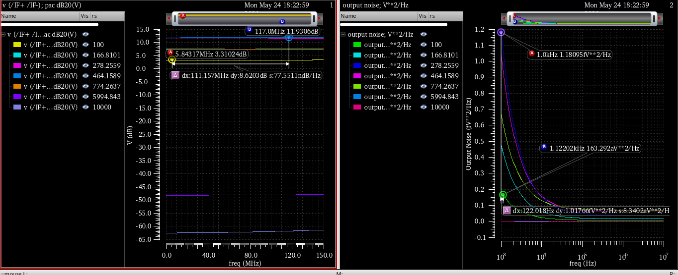
Question #2
Università degli
Studi di Pavia
What is the difference in the gain and noise performance of the mixer if we change the value of output resistance? Write your answer and computation.

Slide 14
Question #3
Università degli
Studi di Pavia
What is the difference in the gain and noise performance of the mixer if we change the size of the switching pair? Write your answer and computation.
Since the gain of the output depends on the voltage drop across the load as the switching pair width increase the the gain aslo increases but on counter balance the output noise also increase same same ratio fro the given load 400ohm at the bais point 1.5mA tail current.
Sl.No | Width of the the switching paire (M) | Out put Gain (db) | OutPut noise (V**2/HZ)
1 | 10u - 1m | 7db - 14db | 1f - 8f

Slide 15
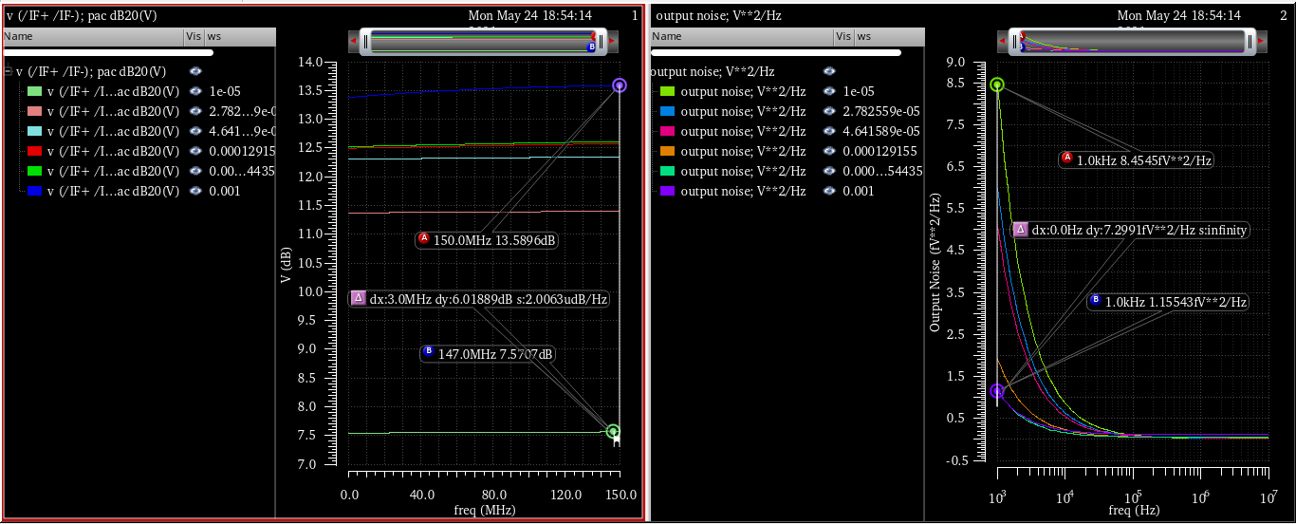
Question #3
Università degli
Studi di Pavia
What is the difference in the gain and noise performance of the mixer if we change the size of the switching pair? Write your answer and computation.

Slide 16
Question #4
Università degli
Studi di Pavia
What is the difference in the gain and noise performance of the mixer if we change the amplitude of the oscillator? Write your answer and computation.
Increaing the feed local oscillator implitide directly IF output through the feed through as the lo amplitude srength increase the feed through increases, this generates output at the if port.
Sl.No | Oscillator gain | Out put Gain (db) | OutPut noise (V**2/HZ)
1 | 0.1 - 1.5 | 7db - 7db | 116a - 6f
2 | Optimum 0.5 | 13db | 1.5f

Slide 17
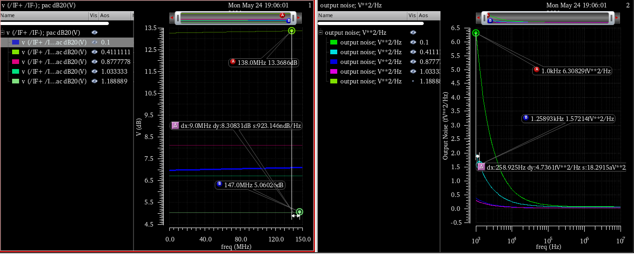
Question #4
Università degli
Studi di Pavia
What is the difference in the gain and noise performance of the mixer if we change the amplitude of the oscillator? Write your answer and computation.

Slide 18
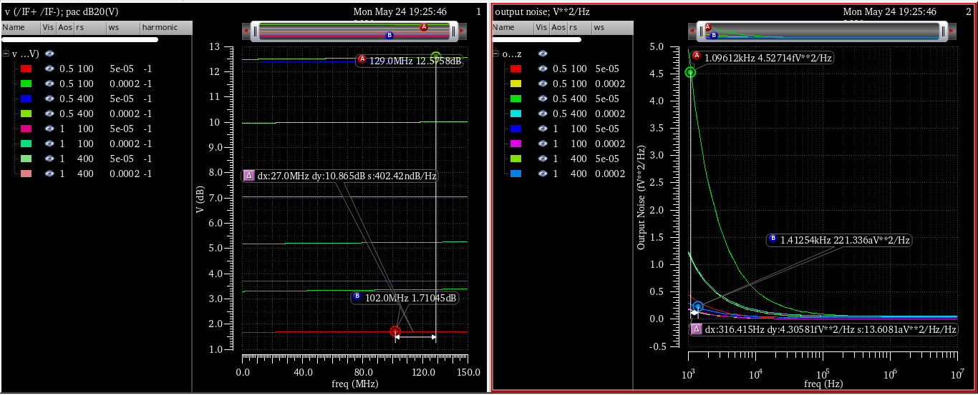
Question #4
Università degli
Studi di Pavia
Conclusion

